Slide 1




14.05.2012
Alexandra David & Dr. Frans Coenen
RSA Conference –
13th - 16th May 2012, Delft University of Technology
Alumni Networks – An untapped potential to attract and gain brains?
Interim Results of the BRAND Project

Slide 2
What is ‚BRAND‘
BRAND stands for Border Regions Alumni Network Development
BRAND is a sub-project of INTERREG IV C Mini-Programme ‘Brain Flow’
funded by the European Regional Development Fund (ERDF)
BRAND has a duration of two years
BRAND consists of five border regions to compare the brain drain phenomenon
and learn from each other

Slide 3
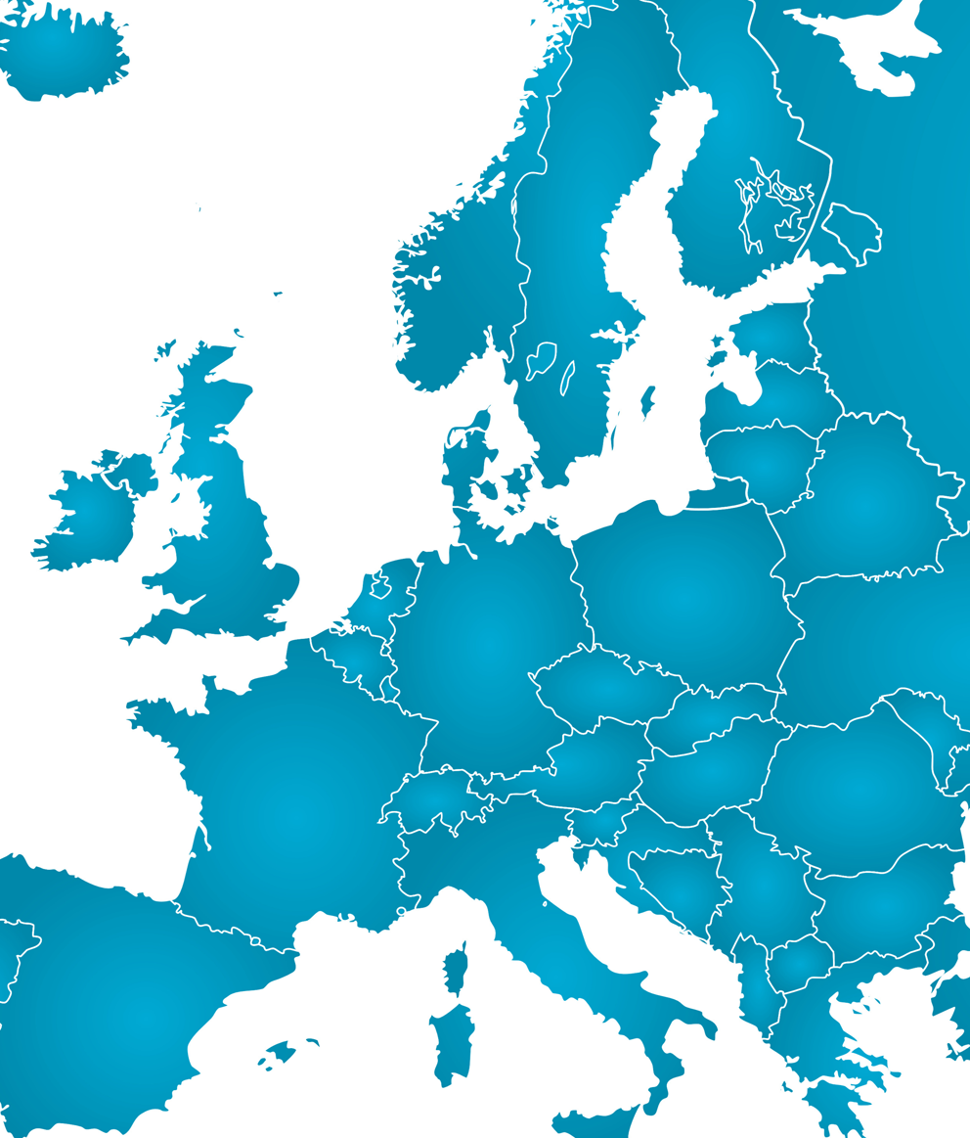
Border Regions
Hedmark
Värmland
Overijssel
NRW
Basel

Slide 4
Key BRAND question?
Can already existing and established formal regional networks
such as alumni networks,
which still keep in touch with once outflowed alumni,
be reoriented and used by broadening their scope of activities
to function as regional promoters, ties and (re)attractors of highly skilled humans?

Slide 5
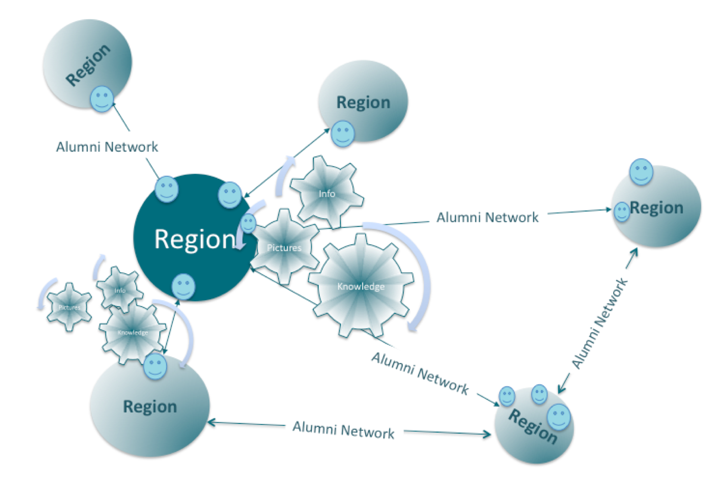
‚BRAND‘ aim and objectives
‘A strong regional and interregional
alumni network in the border regions’
The sub-project has the following objectives:
To achieve knowledge about migration patterns/(re-)migration
To analyse regional alumni networks
To exchange experience about alumni network (the mechanisms behind good practice examples)
To determine regional pictures, images: ‘warm place marketing’,
To create a joint action and business plan for interregional alumni network interlinks and activities
To form policy recommendations at the regional, national and EU-level

Slide 6
How to achieve the aims?
(1) Migration Patterns
May 2011 – September 2011 (5 months)
(2) Analysing and Mapping of Alumni Networks
October 2011 – April 2012 (7 months)
(3) Guideline/Joint Action and Business Plan
May 2012 – April 2013 (12 months)

Slide 7
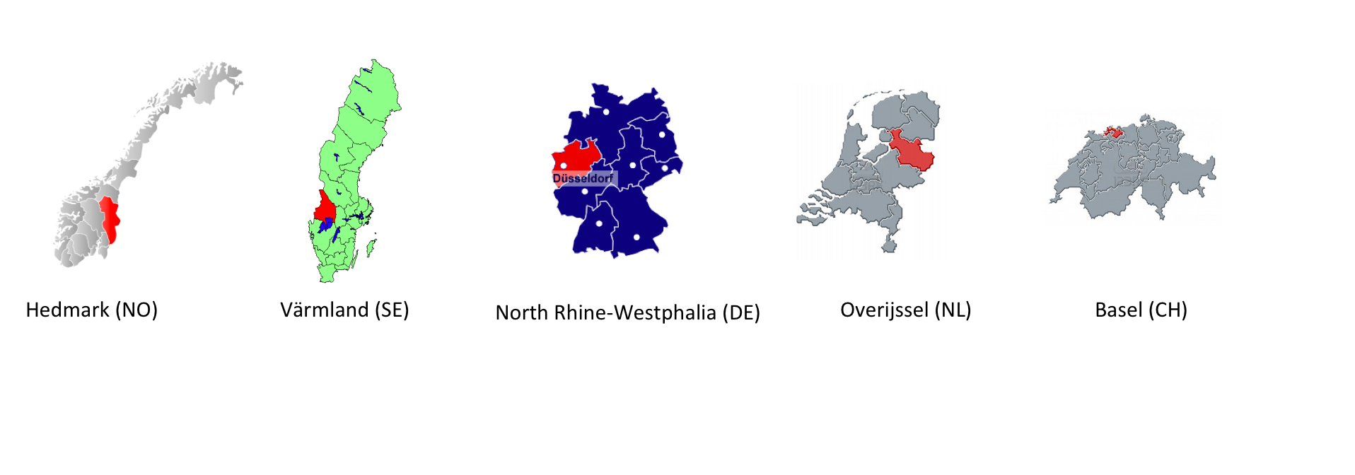
Demand of highly skilled workforce in BRAND regions
Hedmark: demand in health and childcare, rural, less attractive, forest area
Värmland: high unemployment rate, rural, educational level of young men is below the national average
Overijssel: less attractive to career starters, some part are very rural, SME driven economy
Basel: positive net migration, but often xenophobia, own education level decreases
NRW:
Münsterland: rural and only the city Münster is attractive
Bochum: old industrial image
Lower Rhine: communication mismatch economy/university

Slide 8
Importance of highly skilled workers for regions
Knowledge is the driving force for innovation and regional development (Trippl/Maier 2007, Growe 2009, Heßler 2008)
Knowledge is anchored in human capital
Not only the quantity, also the quality of human capital count (Champion 2011)
Concentration on highly skilled workers

Slide 9
Highly skilled as knowledge carrier
Knowledge identification/generation
Knowledge Examination
Knowledge Spillovers
Knowledge
Exploitation
Regional Level
Regional Level
Interregional Level
Regional Level
Gatekeepers of Knowledge (Morris 2008)

Slide 10
Importance of external knowledge
Internal knowledge is crucial for regional development
But, external knowledge can bring new stimuli to regions
Is inspiring for innovations, clusters life cycles etc.
Can break regional path, so that regions don’t run the
danger to become inflexible – no lock ins

Slide 11
Retention and (Re)attraction of highly skilled
Mobility of highly skilled is one of the key channels of interregional knowledge spillover (Faggian and McCann (2009)
Metropolitan areas seem to be more attractive
Often border regions and among them, notably rural regions are hit by negative brain flow and outmigration
Regions suffering from a lack of highly skilled workforce should develop retention and (re)attraction instruments to specific target groups

Slide 12
Conjoint Analyse – Overall Results
Attraction of the economic region depending on the place of birth

Slide 13
Alumni Networks as retention and (re)attraction instruments
Transferring the migration network concept to alumni networks
Migration networks act: (a) as decision maker, influencing outmigrants location choice, (b) as door opener in the arrival region, helping migrants simplifying the entrance to the local society and labor markets and (c) as the strongest connection between the home and host region, helping migrants to return, if needed
Alumni networks: (a) in touch with alumni (highly skilled), (b) in best case already bind students, (c) part of university, (d) often the only contact to the former region

Slide 14
ORGANIZATION DEGREE
CH.AN
High-professional organized
MÜ(fa).
AN
BO(U).
AN
OV(fa).
AN
OV(U).
AN
OV(UAS1).AN
BA(U).
AN
Professional organized
VÄ(U).
AN
OV(UAS2).AN
LR (UAS).AN
Well-organized
HE(U).
AN
ALUMNI NETWORK AFFILIATION
Informal/self-organised
Faculty AN
University AN
Umbrella AN
Field of study AN
Univ. of Appl. Science AN
Diagram 1: Alumni network organization degree

Slide 15
ALUMNI NETWORK AFFILIATION
CH.AN
Umbrella AN
BO(U).
AN
BA(U).
AN
OV(U).
AN
HE(U).
AN
VÄ(U).
AN
University AN
LR (UAS).AN
OV(UAS1).AN
University of Applied Science AN
OV(UAS2).AN
OV(fa).
AN
MÜ(fa).
AN
Faculty AN
ALUMNI NETWORK RETENTION&(RE)ATTRACTION ACTIVITIES
Field of study AN
Informal Contact/Personel Relations
Formal Contact
Broad Scope of Activities
Overall Comm. Activities
(Re)Attraction and Binding Activities/Relationship Marketing
Diagram 2: Alumni network retention&(re)attraction activities

Slide 16
Interim Results
Less Alumni Networks cooperate with the region
Few retention and (re)attraction activities
Main alumni networks only inform alumni about the university, and not about
the region
Less exchange with further university organizations such as career centers
Improvements: Management structures, Full-time equivalence,
Increasing of visibility, Exception of the profession
‚Alumni Manager‘, Evaluation

Slide 17
Possible future activities
Warm Place Marketing (binding of students, attraction of international
students by summer schools)
Attraction of former home scientists
Using home coming events for branding of region, regional economy, job offers
Cooperation with career centers, fundrainsing, press etc.

Slide 18
david@iat.eu
www.iat.eu/brand
Notes:
INNO – Innovation, Raum & Kultur
BUTTON - Towards tailored policy measures to attract and retain highly educated workers
BRAND - Border Regions Alumni Network Developement
CURE – Corporate Culture and Regional Embeddedness
WISDOM – Wissen & Kompetenz
TTH / TTH2 - Technologie-Transfer-Ring Handwerk NRW/Evaluierung
ÜSAB - Übergangsmanagement Schule - Ausbildung/Beruf
Unternehmensbefragung (KMU) zur „Ausbildungssituation im Handwerk“
GELL – Gesundheitswirtschaft & Lebensqualität
ZuDi - Zukunft der Dienstleistungen
FLEX PFLEGE - Flexibilisierung und Leiharbeit in der Pflege
WIEGE - Perspektiven für Wiedereinsteiger/Innen in der Gesundheitswirtschaft

